Slide 1



Data Structure
&
Algorithm
Class VIII
lab 10

Slide 2

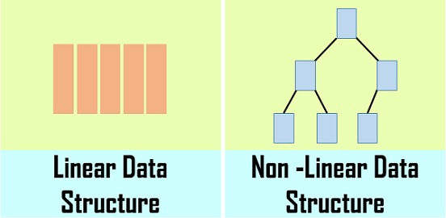
Linear Data Structure
A linear data structure traverses the data elements sequentially, in which only one data element can directly be reached

Slide 3
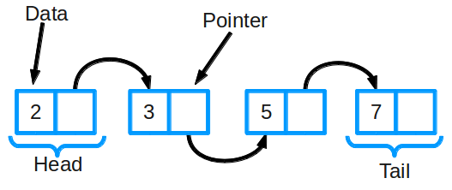
Head/Tail, Top/Bottom,
Linear structures can be thought of as having two ends. Sometimes these ends are referred to as the “left” and the “right” or in some cases the “front” and the “rear.” You could also call them the “top” and the “bottom” or “head” and “tail”.

Slide 4
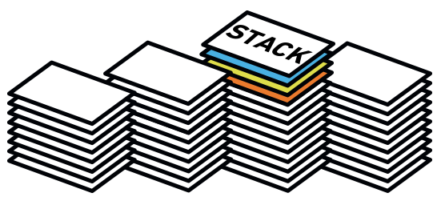
Stack
an ordered collection of items

Slide 5
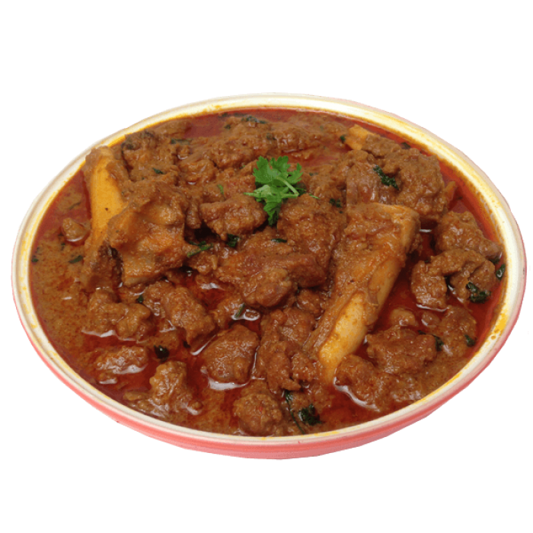

Last in First Out (LIFO)
Look at the stack of paratha.
which paratha is inserted at last
in that stack will be taken at first

Slide 6
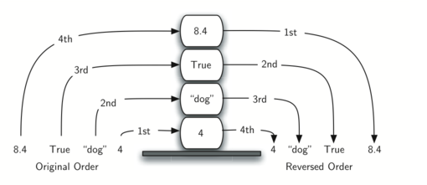
Original vs Reverse
Newer items are near the top, while older items are near the base

Slide 7
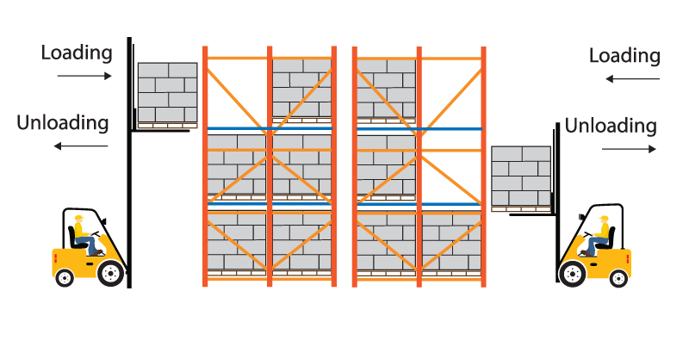
Stack Abstract Data Type
Stack()
push(item)
pop
peek()
isEmpty()
size()

Slide 8
Implementation using Python
from pythonds.basic.stack import Stack s=Stack() print(s.isEmpty()) s.push(4) s.push('dog') print(s.peek()) s.push(True) print(s.size()) print(s.isEmpty()) s.push(8.4) print(s.pop()) print(s.pop()) print(s.size())
pythonds is a module of Python which is used to implement of Data Structure

Slide 9
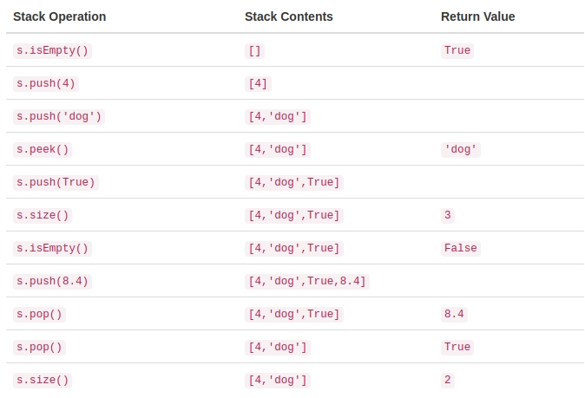
Output

Slide 10


